Slide 1
Notes:
Chapter Thirteen Progress and Performance Measurement and Evaluation

Slide 2
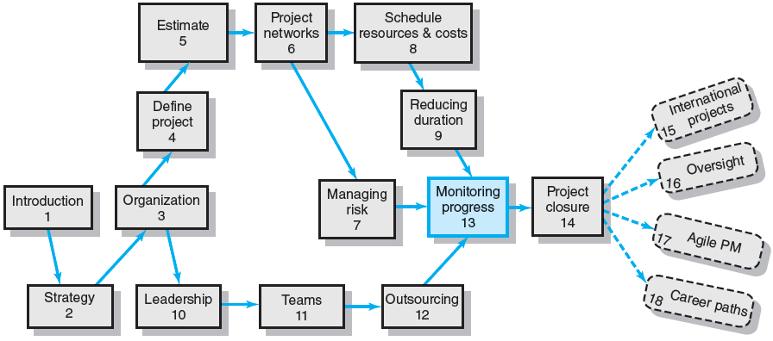
Where We Are Now
Notes:
Chapter 13 reviews how project managers use the information developed from various controls to steer their projects to completion and keep stakeholders informed so timely decisions can be made to ensure the project is managed effectively.
Control and Gantt charts are useful vehicles for monitoring time performance. The cost/schedule system allows the manager to have a positive influence on cost and schedule in a timely manner.
The ability to influence cost decreases with time; timely reports identifying adverse cost trends assist project managers in getting back on budget and schedule. The integrated cost/schedule model provides the project manager and other stakeholders with a snapshot of the current and future status of the project.

Slide 3
Structure of a Project Monitoring Information System
Creating a project monitoring system involves determining:
What data to collect
How, when, and who will collect the data
How to analyze the data
How to report current progress to management
Notes:
A project monitoring system involves determining what data to collect; how, when,
and who will collect the data; analysis of the data; and reporting current progress.

Slide 4
Project Monitoring Information System
Information System Structure
What data are collected?
Current status of project (schedule and cost)
Remaining cost to compete project
Date that project will be complete
Potential problems to be addressed now
Out-of-control activities requiring intervention
Cost and/or schedule overruns and the reasons for them
Forecast of overruns at time of project completion
Notes:
Data collected are determined by which metrics will be used for project control and compared against planned times, resources, and budgets.. Since a major portion of the monitoring system focuses on cost/schedule concerns, it is crucial to provide the project manager and stakeholders with data to answer questions such as:
What is the current status of the project in terms of schedule and cost?
How much will it cost to complete the project?
When will the project be completed?
Are there potential problems that need to be addressed now?
What, who, and where are the causes for cost or schedule overruns?
What did we get for the dollars spent?
If there is a cost overrun midway in the project, can we forecast the overrun at completion?

Slide 5
Project Monitoring System… (cont’d)
Information System Structure (cont’d)
Collecting data and analysis
Who will collect project data?
How will data be collected?
When will the data be collected?
Who will compile and analyze the data?
Reports and reporting
Who will receive the reports?
How will the reports be transmitted?
When will the reports be distributed?
Notes:
With the determination of what data are collected, the next step is to establish who, when, and how the data will be assembled for use by the project manager. Should the reporting period be one hour, one day, one week, or what? Is there a central repository for the data collected and is someone responsible for its dissemination?
The reports must reach the right audience. Different stakeholders and levels of management need different kinds of project information. Senior management’s interests are different from an IT manager working on the project.

Slide 6
Project Progress Report Format
Progress since last report
Current status of project
Schedule
Cost
Scope
Cumulative trends
Problems and issues since last report
Actions and resolution of earlier problems
New variances and problems identified
Corrective action planned
Notes:
Typically, project progress reports are designed and communicated in written or oral form. An example of the common topic format for progress reports is:
Progress since last report
Current status of project versus budget and/or time unit estimates
Schedule
Cost
Scope
Cumulative trends
Problems and issues since last report
Actions and resolution of earlier problems
New variances and problems identified
Corrective action planned

Slide 7
The Project Control Process
Control
The process of comparing actual performance against plan to identify deviations, evaluate courses of action, and take appropriate corrective action.
Project Control Steps
Setting a baseline plan.
Measuring progress and performance.
Comparing plan against actual.
Taking action.
Tools
Tracking and baseline Gantt charts
Control charts
Notes:
Control is the process of comparing actual performance against plan to identify deviations, evaluate courses of action, and take appropriate corrective action.
Project control steps include setting a baseline plan, measuring progress and performance, comparing plan against actual and taking corrective action.
Common tools used by project managers in the project control process are tracking and baseline Gantt charts and process control charts

Slide 8
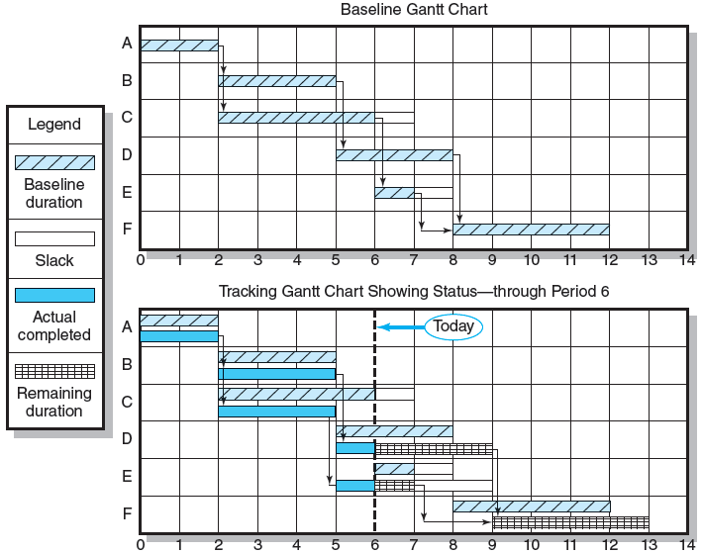
Baseline and Tracking Gantt Charts
FIGURE 13.1
Notes:
Figure 13.1 presents a baseline Gantt chart and a tracking Gantt chart for a project at the end of period 6. The solid bar below the original schedule bar represents the actual start and finish times for completed activities or any portion of an activity completed (see activities A, B, C, D, and E).
For example, the actual start time for activity C is period 2; the actual finish time is period 5; the actual duration is three time units, rather than four scheduled time periods. Activities in process show the actual start time; the extended bar represents the expected remaining duration (see activities D and E). The remaining duration for activities D and E are shown with the hatched bar. Activity F, which has not started, shows a revised estimated actual start (9) and finish time (13).
Note how activities can have durations that differ from the original schedule, as in activities C, D, and E. Either the activity is complete and the actual is known, or new information suggests the estimate of time be revised and reflected in the status report. Activity D’s revised duration results in an expected delay in the start of activity F. The project is now estimated to be completed one period later than planned. Although sometimes the Gantt chart does not show dependencies, when it is used with a network, the dependencies are easily identified if tracing is needed.

Slide 9
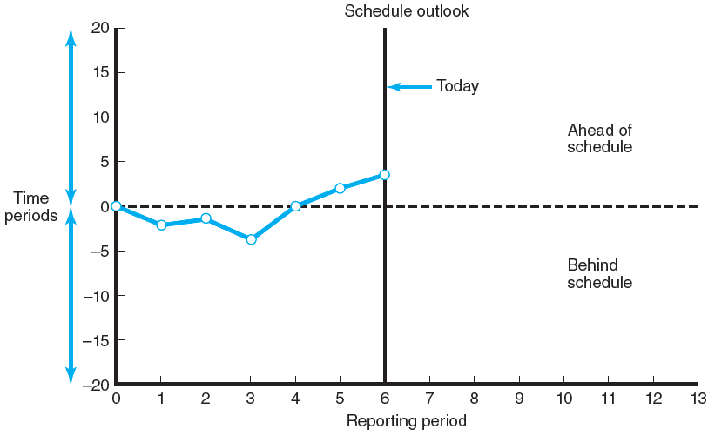
Project Schedule Control Chart
FIGURE 13.2
Notes:
Figure 13.2 depicts how a project control chart is used to monitor past project schedule performance and current performance and to estimate future schedule trends. The chart is used to plot the difference between the scheduled time (on the vertical axis) on the critical path at the report date (on the horizontal axis) with the actual point on the critical path.
Although Figure 13.2 shows the project was behind early in the project, the plot suggests corrective action brought the project back on track. If the trend is sustained, the project will come in ahead of schedule. Because the activity scheduled times represent average durations, four observations trending in one direction indicate there is a very high probability that there is an identifiable and correctable cause for the variation. Control chart trends are very useful for giving advance warning of potential problems so appropriate action can be taken if necessary.
Control charts are also frequently used to monitor progress toward milestones, which mark events and as such have zero duration. Control charts very similar to the example shown in Figure 13.2 are often used to record and communicate project progress toward a milestone.

Slide 10
Development of an Earned Value Cost/Schedule System
Time-Phase Baseline Plan
Corrects the failure of most monitoring systems to connect a project’s actual performance to its schedule and forecast budget.
Systems that measure only cost variances do not identify resource and project cost problems associated with falling behind or progressing ahead of schedule.
Earned Value Cost/Schedule System
An integrated project management system based on the earned value concept that uses a time-phased budget baseline to compare actual and planned schedule and costs.
Notes:
A time-phase baseline plan corrects for the failure of monitoring systems to connect a project’s actual performance to its schedule and forecast budget. Systems that measure only cost variances do not identify resource and project cost problems associated with falling behind or progressing ahead of schedule.
An earned value cost/schedule system is an integrated project management system based on the earned value concept that uses a time-phased budget baseline to compare actual and planned schedule and costs.

Slide 11
Glossary of Terms
EV | Earned value for a task is simply the percent complete times its original budget. Stated differently, EV is the percent of the original budget that has been earned by actual work completed.
PV | The planned time-phased baseline of the value of the work scheduled. An approved cost estimate of the resources scheduled in a time-phased cumulative baseline [BCWS—budgeted cost of the work scheduled].
AC | Actual cost of the work completed. The sum of the costs incurred in accomplishing work. [ACWP—actual cost of the work performed].
CV | Cost variance is the difference between the earned value and the actual costs for the work completed to date where CV = EV – AC.
SV | Schedule variance is the difference between the earned value and the baseline line to date where SV = EV – PV.
BAC | Budgeted cost at completion. Total budgeted cost of the baseline or project cost accounts.
EAC | Estimated cost at completion.
ETC | Estimated cost to complete remaining work.
VAC | Cost variance at completion. VAC indicates expected actual over- or under-run cost at completion.
TABLE 13.1
Notes:
Table 13.1 presents a glossary of the acronyms and equations used by the earned value cost/schedule system for analysis. In recent years acronyms have been shortened to be more phonetically friendly. The acronyms found in brackets represent the older acronyms, which are often found in software programs. To the uninitiated, the terms used in practice appear horrendous and intimidating. However, once a few basic terms are understood, the intimidation factor decreases considerably.

Slide 12
Developing an Integrated Cost/Schedule System
Define the work using a WBS.
Scope
Work packages
Deliverables
Organization units
Resources
Budgets
Develop work and resource schedules.
Schedule resources to activities
Time-phase work packages into a network
Develop a time-phased budget using work packages included in an activity. Accumulate budgets (PV).
At the work package level, collect the actual costs for the work performed (AC). Multiply percent complete times original budget (EV).`
Compute the schedule variance (EV-PV) and the cost variance (EV-AC).
Notes:
Following these five steps will help ensure that a cost/schedule system is integrated:
Define the work using a WBS.
Scope
Work packages
Deliverables
Organization units
Resources
Budgets for each work package
Develop work and resource schedules.
Schedule resources to activities
Time-phase work packages into a network
Develop a time-phased budget using work packages included in an activity. Accumulate budgets (PV).
At the work package level, collect the actual costs for the work performed (AC). Multiply percent complete times original budget (EV).`
Compute the schedule variance (EV-PV) and the cost variance (EV-AC).

Slide 13
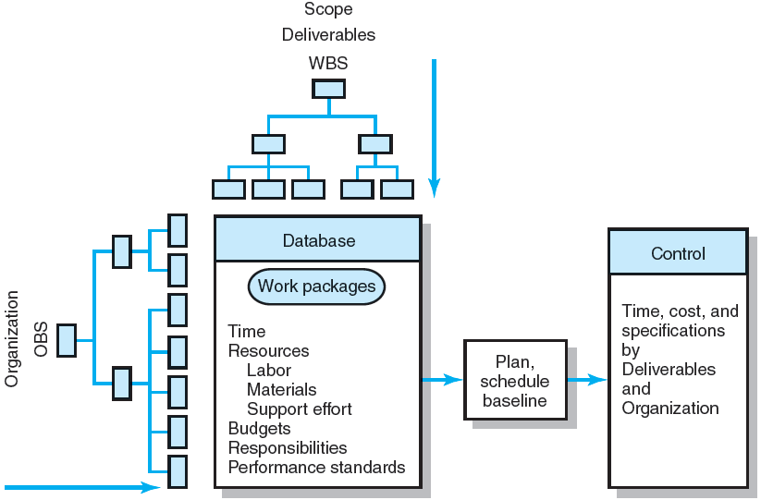
Project Management Information System Overview
FIGURE 13.3
Notes:
Figure 13.3 presents a schematic overview of the integrated information system, which includes the techniques and systems presented in earlier chapters. Steps 1 and 2 are already carefully developed. In the overview, control data can be traced backward to specific deliverables and organization unit responsible.

Slide 14
Development of Project Baselines (cont’d)
Rules for Placing Costs in Baselines
Costs are placed exactly as they are expected to be “earned” in order to track them to their point of origin.
Percent Complete Rule
Costs are periodically assigned to a baseline as units of work are completed over the duration of a work package.
Notes:
The percent complete rule is the heart of any earned value system. The best method for assigning costs to the baseline under this rule is to establish frequent checkpoints over the duration of the work package and assign completion percentages in dollar terms. Units might be lines of code, hours, drawings completed, cubic yards of concrete in place, workdays, prototypes complete, etc.
The general rule for placing costs in baselines is costs are placed exactly as they are expected to be “earned” in order to track them to their point of origin.

Slide 15
Development of Project Baselines
Purposes of a Baseline (PV)
An anchor point for measuring performance
A planned cost and expected schedule against which actual cost and schedule are measured.
A basis for cash flows and awarding progress payments.
A summation of time-phased budgets (cost accounts as summed work packages) along a project timeline.
What Costs Are Included in Baselines?
Labor, equipment, materials, project direct overhead costs (DOC)
Notes:
The purposes of a project Baseline (PV) are that it serves as an anchor point for measuring present performance in the following ways:
A planned cost and expected schedule against which actual cost and schedule are measured.
A basis for cash flows and awarding progress payments.
A summation of time-phased budgets (cost accounts as summed work packages) along a project timeline.
Costs commonly included in baselines are labor, equipment, materials, project direct overhead costs (DOC).

Slide 16
Methods of Variance Analysis
Comparing Earned Value
With the expected schedule value.
With the actual costs.
Assessing Status of a Project
Required data elements
Data Budgeted cost of the work scheduled (PV)
PV =the planned time-phased baseline of the value of the work schedule
Budgeted cost of the work completed (EV)- Earned value
EV = The percent complete times its original budge
Actual cost of the work completed (AC)
Calculate schedule and cost variances
A positive variance indicates a desirable condition, while a negative variance suggests problems or changes that have taken place.
Notes:
Generally the method for measuring accomplishments centers on two key computations:
1. Comparing earned value with the expected schedule value.
2. Comparing earned value with the actual costs.
These comparisons can be made at the project level or down to the cost account level.
Assessing project status can be determined for the latest period, all periods to date, and estimated to the end of the project.
Assessment requires assembling the following data elements:
Data budgeted cost of the work scheduled (PV)
Budgeted cost of the work completed (EV)
Actual cost of the work completed (AC)
When calculating schedule and cost variances to determine the status of a project, a positive variance indicates a desirable condition, while a negative variance suggests problems or changes that have taken place.

Slide 17
Methods of Variance Analysis
Cost Variance (CV)
Indicates if the work accomplished using labor and materials costs more or less than was planned at any point in the project.
CV= EV – AC
Schedule Variance (SV)
Presents an overall assessment in dollar terms of the progress of all work packages in the project scheduled to date.
SV = EV - PV
Notes:
In the analysis of variance in a project, a cost variance (CV) indicates if the work accomplished using labor and materials costs more or less than was planned at any point in the project. A schedule variance (SV) presents an overall assessment in dollar terms of the progress of all work packages in the project scheduled to date.

Slide 18
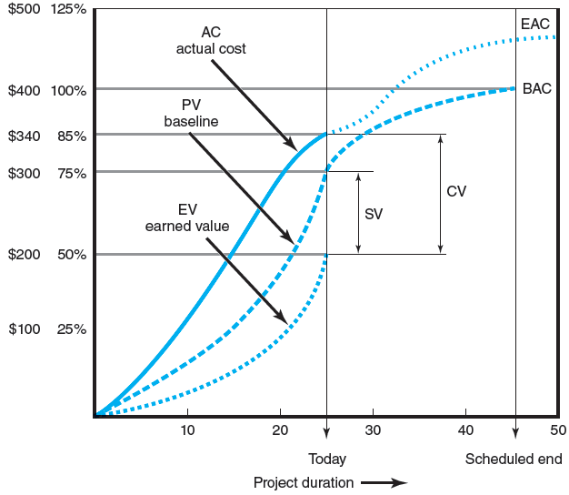
Cost/Schedule Graph
FIGURE 13.4
Notes:
Figure 13.4 presents a sample cost/schedule graph with variances identified for a project at the current status report date. The graph focuses on what remains to be accomplished and any favorable or unfavorable trends. The “today” label marks the report date (time period 25) of where the project has been and where it is going. Because our system is hierarchical, graphs of the same form can be developed for different levels of management.
In Figure 13.4 the top line represents the actual costs (AC) incurred for the project work to date. The middle line is the baseline (PV) and ends at the scheduled project duration (45). The bottom line is the budgeted value of the work actually completed to date (EV) or the earned value. The dotted line extending the actual costs from the report date to the new estimated completion date represents revised estimates of expected actual costs; that is, additional information suggests the costs at completion of the project will differ from what was planned. Note that the project duration has been extended and the variance at completion (VAC) is negative (BAC – EAC).
Another interpretation of the graph uses percentages. At the end of period 25, 75 percent of the work was scheduled to be accomplished. At the end of period 25, the value of the work accomplished is 50 percent. The actual cost of the work completed to date is $340, or 85 percent of the total project budget. The graph suggests the project will have about a 18 percent cost overrun and be five time units late. The current status of the project shows the cost variance (CV) to be over budget by $140 (EV – AC = 200 – 340 = – 140). The schedule variance (SV) is negative $100 (EV – PV = 200 – 300 = – 100), which suggests the project is behind schedule.

Slide 19
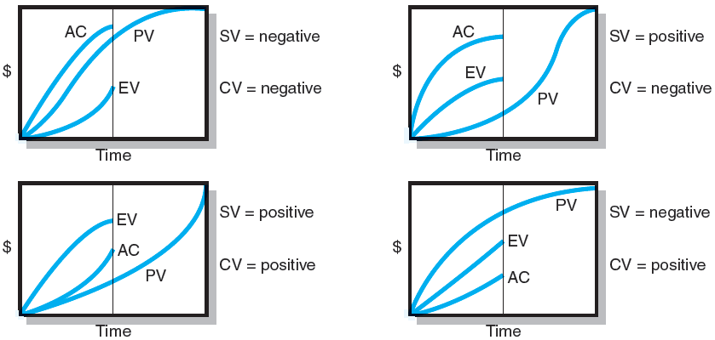
Earned-Value Review Exercise
FIGURE 13.5
Notes:
Figure 13.5 presents four different earned-value cost/schedule graphs for students to use for practice in interpreting the outcomes of cost/schedule graphs. Remember, PV is your baseline and anchor point.

Slide 20
Developing A Status Report: A Hypothetical Example
Assumptions
Each cost account has only one work package, and each cost account will be represented as an activity on the network.
The project network early start times will serve as the basis for assigning the baseline values.
From the moment work an activity begins, some actual costs will be incurred each period until the activity is completed.
Notes:
This slide presents the initial assumptions on which an example hypothetical status report will be developed. The assumptions are that:
Each cost account has only one work package, and each cost account will be represented as an activity on the network.
The project network early start times will serve as the basis for assigning the baseline values.
From the moment work an activity begins, some actual costs will be incurred each period until the activity is completed.

Slide 21
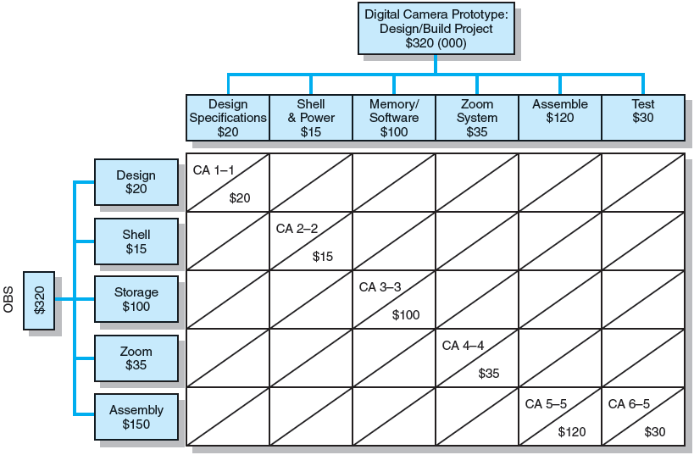
Work Breakdown Structure with Cost Accounts
FIGURE 13.6
Notes:
Figure 13.6 depicts a simple row and column chart of the work breakdown structure (WBS/OBS) with cost accounts for the Digital Camera example in the textbook. There are six deliverables (Design Specifications, Shell & Power, Memory/Software, Zoom System, Assemble, and Test) on the column axis, and five responsible departments (Design, Shell, Storage, Zoom, and Assembly) on the row axis. The total for all the cost accounts (CA) is $320,000, which represents the total project cost.

Slide 22
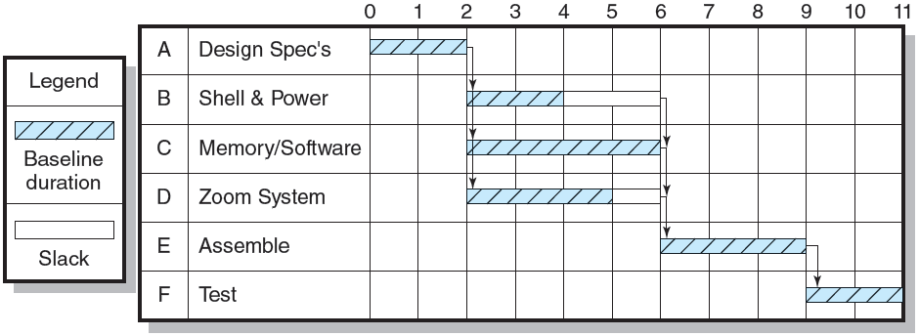
Digital Camera Prototype Project Baseline Gantt Chart
FIGURE 13.7
Notes:
Figure 13.7, using information derived from the WBS, presents a row and column formatted planning Gantt chart for the Digital Camera project. The planned project duration is 11 time units. This project information is used to time-phase the project budget baseline.

Slide 23
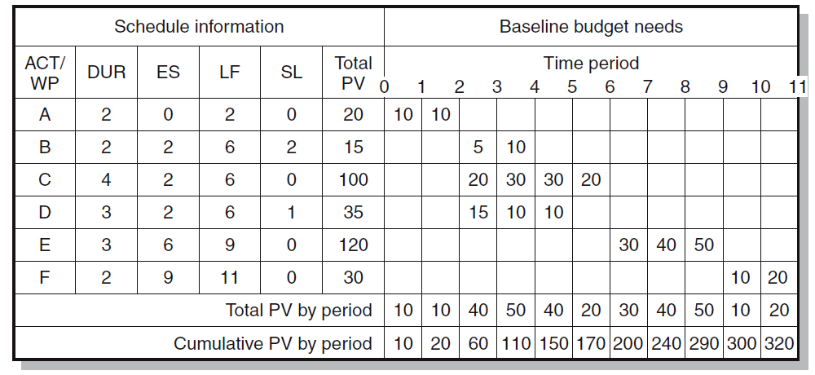
Digital Camera Prototype Project Baseline Budget ($000)
FIGURE 13.8
Notes:
Figure 13.8 presents a row and column worksheet with an early start baseline developed with costs assigned. They are assigned “exactly” as managers plan to monitor and measure schedule and cost performance.

Slide 24
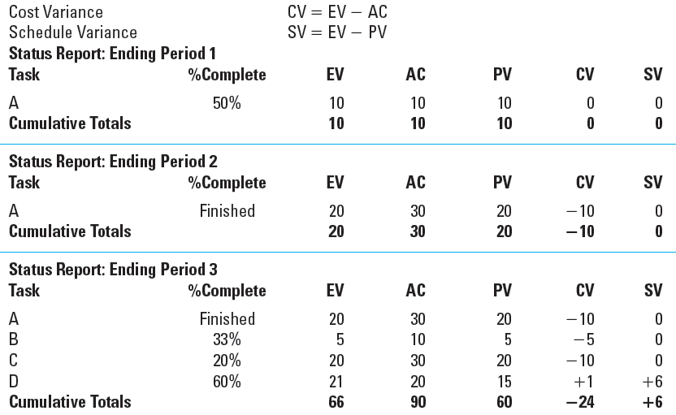
Digital Camera Prototype Status Reports: Periods 1–3
TABLE 13.2
Notes:
Table 13.2 presents the completed, separate status reports in row and column format of the Digital Camera Prototype project for periods 1 through 7. Each period percent complete and actual cost were gathered for each task from staff in the field. The schedule and cost variance are computed for each task and the project to date.
For example, the status in period 1 shows only Task A (Design Specifications) is in process and it is 50 percent complete and actual cost for the task is 10. The planned value at the end of period 1 for Task A is 10 (see Figure 13.8). The cost and schedule variance are both zero, which indicates the project is on budget and schedule. By the end of period 3, Task A is finished. Task B (Shell & Power) is 33 percent complete and AC is 10; Task C is 20 percent complete and AC is 30; and D is 60 percent complete and AC is 20.
Again, from Figure 13.8 at the end of period 3, we can see that the PV for Task A is 20 (10 + 10 = 20), for Task B is 5, for Task C is 20, and for Task D is 15. At the end of period 3 it is becoming clear the actual cost (AC) is exceeding the value of the work completed (EV). The cost variance (see Table 13.2) for the project at the end of period 3 is negative 24. Schedule variance is positive 6, which suggests the project may be ahead of schedule.

Slide 25
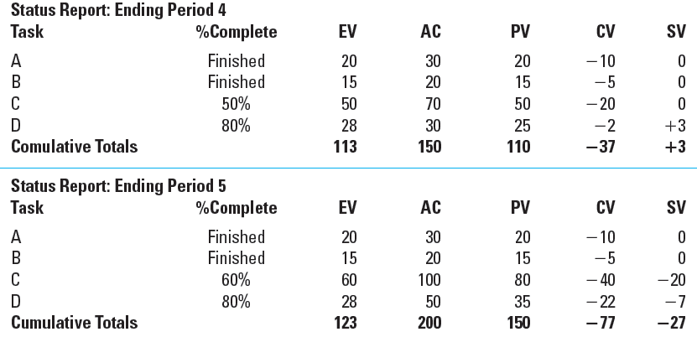
Digital Camera Prototype Status Reports: Periods 4 & 5
TABLE 13.2 (cont’d)

Slide 26
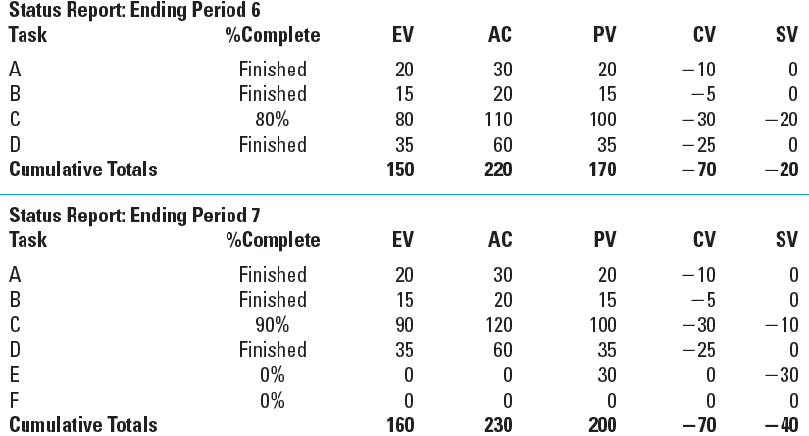
Digital Camera Prototype Status Reports: Periods 6 & 7
TABLE 13.2 (cont’d)
Notes:
By studying the separate status reports for periods 5 through 7, you can see the
project will be over budget and behind schedule. By period 7 Tasks A, B, and D
are finished, but all are over budget—negative 10, 5, and 25. Task C (Memory/
Software) is 90 percent complete. Task E is late and hasn’t started because Task C
is not yet completed. The result is that, at the end of period 7, the digital camera
project is over budget $70,000, with a schedule budget over $40,000.

Slide 27
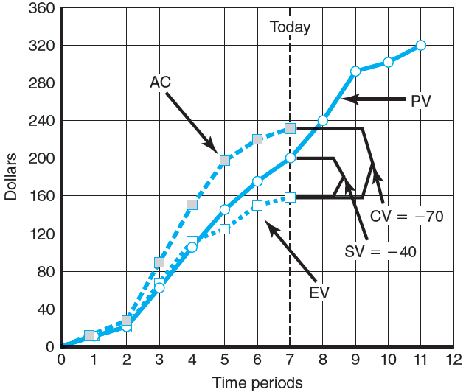
Digital Camera Prototype Summary Graph ($000)
FIGURE 13.9
Notes:
Figure 13.9 shows the graphed results of all the status reports through period 7. This graph represents the data from Table 13.2. The cumulative actual costs (AC) to date and the earned value budgeted costs to date (EV) are plotted against the original project baseline (PV). The cumulative AC to date is $230; the cumulative EV to date is $160. Given these cumulative values, the cost variance (CV = EV – AC) is negative $70 (160 – 230 = 270). The schedule variance (SV = EV – PV) is negative $40 (160 – 200 = 240). Again, recall that only the project network or Tracking Gantt chart can give an accurate assessment of schedule performance down to the work package level.

Slide 28
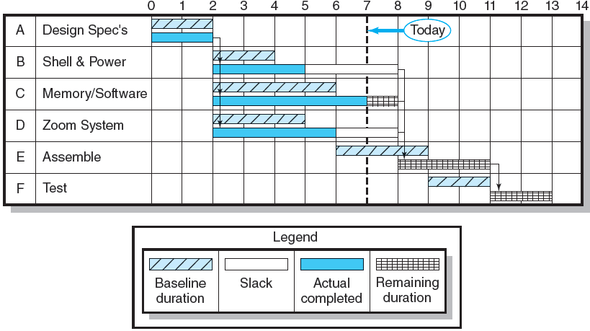
Digital Camera Project-Tracking Gantt Chart Showing Status—Through Period 7
FIGURE 13.10
Notes:
A tracking Gantt bar chart for the Digital Camera Prototype is shown in Figure 13.10. From this figure you can see Task C (Memory/Software), which had an original duration of 4 time units, now is expected to require 6 time units. This delay of 2 time units for Task C will also delay Tasks E and F two time units and result in the project being late 2 time periods.

Slide 29
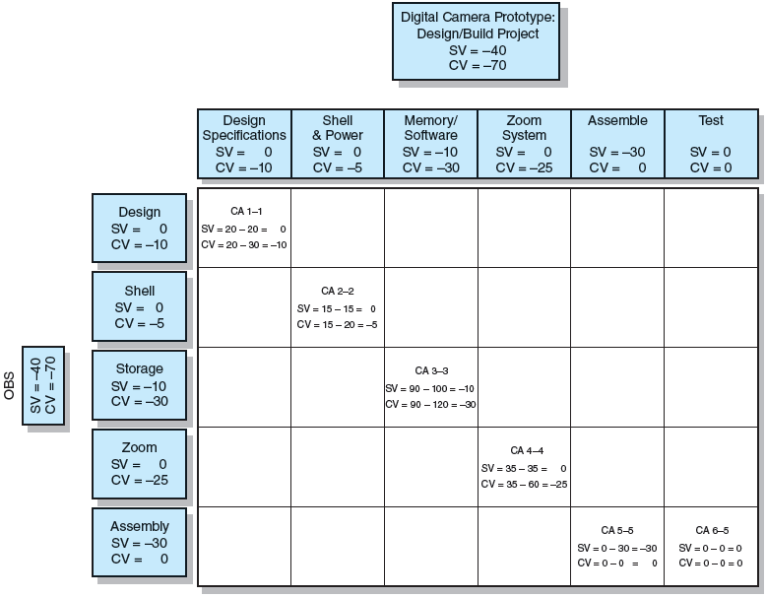
Project Rollup End Period 7 ($000)
FIGURE 13.11
Notes:
Figure 13.11 shows an oversimplified project rollup at the end of period 7 in row and column format. The rollup is by deliverables and organization units. For example, the Memory/Software deliverable has an SV of $ 210 and a CV of 230. The responsible “Storage” department should have an explanation for these variances. Similarly, the assembly department, which is responsible for the Assemble and Test deliverables, has an SV of $ 230 due to the delay of Task C (see Figure 13.10). Most deliverables look unfavorable on schedule and cost variance.

Slide 30
Indexes to Monitor Progress
Performance Indexes
Cost Performance Index (CPI)
Measures the cost efficiency of work accomplished to date.
CPI = EV/AC
Scheduling Performance Index (SPI)
Measures scheduling efficiency
SPI = EV/PV
Percent Complete Indexes
Indicate how much of the work accomplished represents of the total budgeted (BAC) and actual (AC) dollars to date.
PCIB = EV/BAC
PCIC = AC/EAC
Notes:
Three performance indexes used to measure trends in a project’s performance efficiencies are:
The cost performance index (CPI) which measures the cost efficiency of work accomplished to date (CPI = EV/AC)
The scheduling performance index (SPI) measures scheduling efficiency (SPI = EV/PV)
Percent complete indexes indicate how much of the work accomplished represents of the total budgeted (BAC) and actual (AC) dollars to date.
PCIB = EV/BAC
PCIC = AC/EAC

Slide 31
Interpretation of Indexes
Index | Cost (CPI) | Schedule (SPI)
>1.00 | Under cost | Ahead of schedule
=1.00 | On cost | On schedule
<1.00 | Over cost | Behind schedule
TABLE 13.3
Notes:
Table 13.3 presents the interpretation of the indexes that are typically used at the cost account level and above. In practice, the database is also used to develop indexes that allow the project manager and customer to view progress from several angles. An index of 1.00 (100 percent) indicates progress is as planned (on schedule). An index greater than 1.00 shows progress is better than expected (ahead of schedule). An index less than 1.00 suggests progress is poorer than planned (behind schedule) and deserves attention.

Slide 32
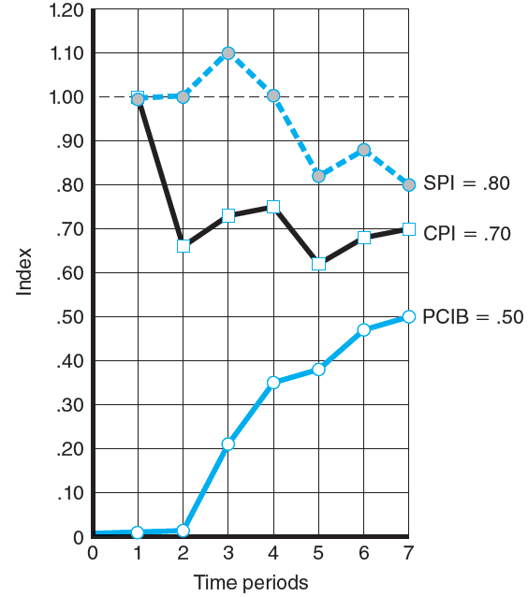
Indexes Periods 1–7
FIGURE 13.12
Notes:
Figure 13.12 shows the two efficiency indexes and baseline for the textbook example project through period 7 plotted as a row and column chart.
The first index measures cost efficiency of the work accomplished to date using data from Table 13.2. Calculation of the cost performance index (CPI) = EV/AC = 160/230 = .696 or .70 The CPI of .696 shows that $.70 worth of work planned to date has been completed for each $1.00 actually spent—an unfavorable situation indeed. The CPI is the most accepted and used index. It has been tested over time and found to be the most accurate, reliable, and stable.
The second index is a measure of scheduling efficiency to date, the scheduling performance index (SPI) = EV/PV = 160/200 = .80 The schedule index indicates $.80 worth of work has been accomplished for each $1.00 worth of scheduled work to date.

Slide 33
Additional Earned Value Rules
Rules applied to short-duration activities and/or small-cost activities
0/100 percent rule
Assumes 100 % of budget credit is earned at once and only when the work is completed.
50/50 rule
Allows for 50% of the value of the work package budget to be earned when it is started and 50% to be earned when the package is completed.
Percent complete with weighted monitoring gates
Uses subjective estimated percent complete in combination with hard, tangible monitoring points.
Notes:
Additional earned value rules that can be applied to short-duration activities and/or small-cost activities are:
The 0/100 percent rule which assumes 100 % of budget credit is earned at once and only when the work is completed.
The 50/50 rule which allows for 50% of the value of the work package budget to be earned when it is started and 50% to be earned when the package is completed.
The percent complete with weighted monitoring gates technique uses subjective estimated percent complete in combination with hard, tangible monitoring points.

Slide 34
Forecasting Final Project Cost
Methods used to revise estimates of future project costs:
EAC_{re}
Allows experts in the field to change original baseline durations and costs because new information tells them the original estimates are not accurate.
EAC_{f}
Uses actual costs-to-date plus an efficiency index to project final costs in large projects where the original budget is unreliable.
Notes:
When forecasting final project cost, project managers can use two methods to revise their original estimates of project times and costs to bring them in line with present project circumstances:
EAC_{re} allows experts in the field to change original baseline durations and costs because new information tells them the original estimates are not accurate.
EAC_{f} uses actual costs-to-date plus an efficiency index to project final costs in large projects where the original budget is unreliable.

Slide 35
Forecasting Model: EAC_{f}
The equation for this forecasting model:
Notes:
The equation for the forecasting model EAC_{f is as follows}:

Slide 36
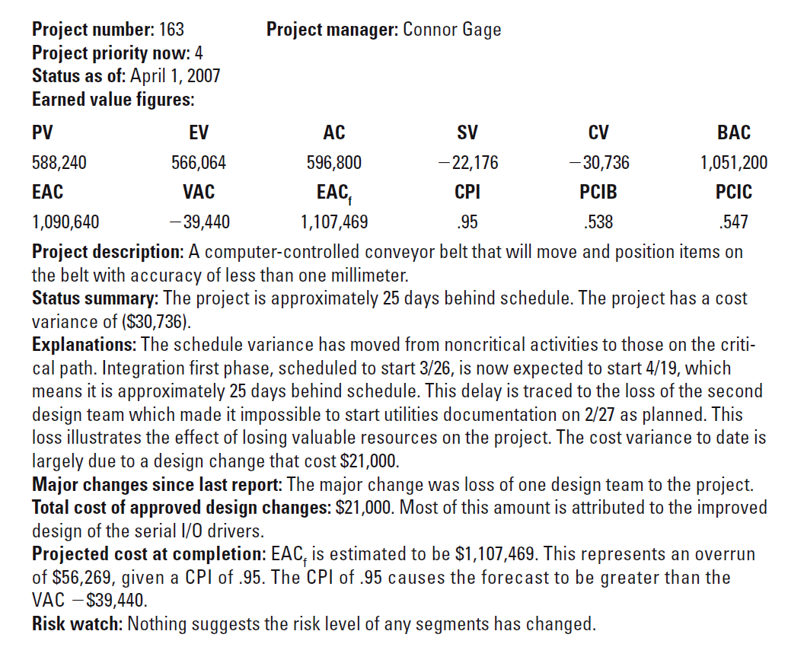
Monthly Status Report
EXHIBIT 13.1
Notes:
Exhibit 13.1 presents a sample of an abridged monthly status report similar to one used by a project organization. The form is used for all projects in their project portfolio. (Note that the schedule variance of –$22,176 does not translate directly to days. The 25 days were derived from the network schedule.)

Slide 37
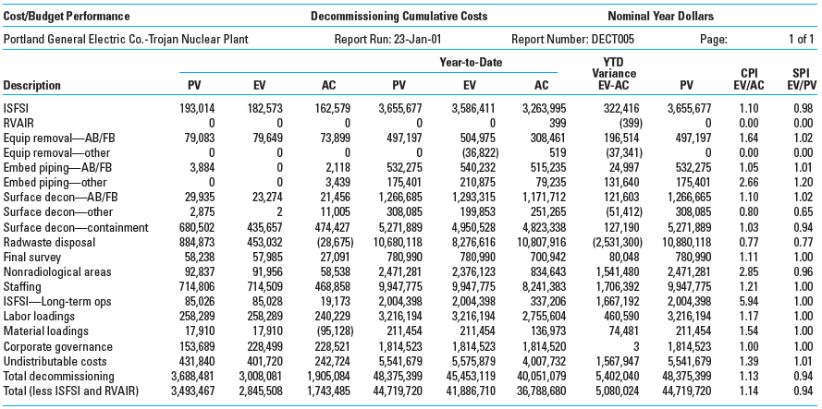
Trojan Nuclear Plant Decommissioning Earned Value Status Report
EXHIBIT 13.2
Notes:
Exhibit 13.2 shows the earned value status report for Portland General Electric Company’s Trojan Decommissioning Project. This row and column format report measures schedule and cost performance for monitoring the project. The report also serves as a basis for funding for rate filings with the Public Utilities Commission.
The SPI (0.94) suggests the project schedule is falling behind. Resolving issues with a major vendor and solutions for technical problems should solve these delay problems. The CPI (1.14) for the project is positive. Some of this good cost performance is attributed to partnering and incentive arrangements with vendors and labor unions.

Slide 38
Other Control Issues
Issues In Maintaining Control Of Projects
Scope Creep
Baseline Changes
Data Acquisition Costs and Problems
Notes:
Major issues that project managers face in maintaining control of projects are scope creep, baseline changes, and data acquisition costs and collection problems

Slide 39
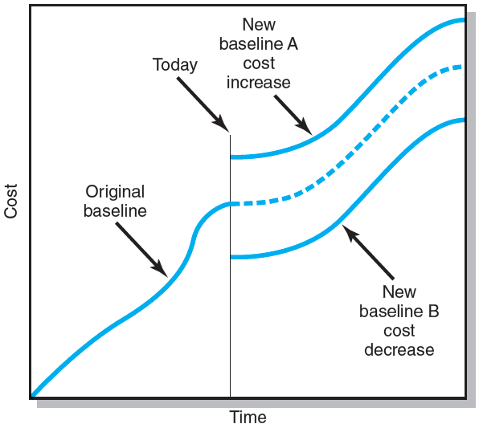
Scope Changes to a Baseline
FIGURE 13.13
Notes:
Figure 13.13 depicts the cost impact of a scope change on the baseline at a point in time—“today.” Line A represents a scope change that results in an increase in cost. Line B represents a scope change that decreases cost. Quickly recording scope changes to the baseline keeps the computed earned values valid. Failure to do so results in misleading cost and schedule variances.

Slide 40
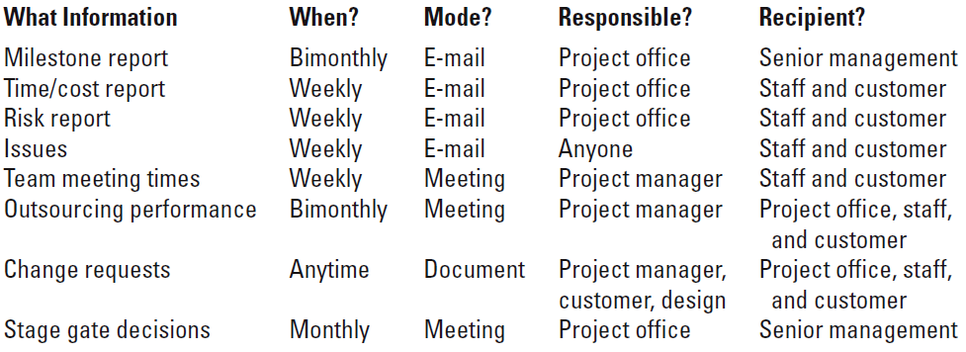
Conference Center WiFi Project Communication Plan
FIGURE 13.14
Notes:
Figure 13.14 presents in row and column format the internal communication plan for a hypothetical WiFi Project. Project managers who develop communication plans in the project planning stage can greatly mitigate the problem of having information reach the right people in a timely manner by mapping out the expected flow of project information to keep stakeholders informed on all aspects of project progress and issues.

Slide 41
Key Terms
Baseline budget
Budget at completion (BAC)
Control chart
Cost performance index (CPI)
Cost variance (CV)
Earned value (EV)
Estimated Cost at Completion—Forecasted (EAC_{f})
Estimated Cost at Completion—Revised Estimates (EAC_{re})
Percent complete index—budget costs (PCIB)
Percent complete index—actual costs (PCIC)
Schedule performance index (SPI)
Schedule variance (SV)
Scope creep
To complete performance index (TCPI)
Tracking Gantt chart
Variance at completion (VAC)
Notes:
Baseline budget represents the first real plan with cost, schedule, and resource allocations that can be used as an anchor point for measuring actual cost and schedule performance.
Budget at completion (BAC) is the he total budgeted cost of the baseline or project cost accounts
Control chart measures positive and negative variations in performance from a standard.
Cost performance index (CPI) is the ratio of work performed to actual costs (EV/AC).
Cost variance (CV) is the difference between EV and AC (CV = EV – AC).
Earned value (EV) is the value of the physical work accomplished plus the authorized budget for this work.
Estimated Cost at Completion—Forecasted (EACf) is a formula-estimated sum of actual costs to date plus revised estimated costs for the work remaining in the WBS.
Estimated Cost at Completion—Revised Estimates (EACre) is a industry expert-estimated sum of actual costs to date plus revised estimated costs for the work remaining in the WBS.
Schedule performance index (SPI) is the ratio of work performed to work scheduled (EV/PV).
Schedule variance (SV) is the difference between planned dollar value of the work actually completed and value of the work scheduled to be completed at a point in time (SV = EV – PV).
Scope creep is the tendency for the scope of a project to expand once it has started.
Tracking Gantt chart compares planned versus actual schedule information.
Variance at completion (VAC) indicates expected actual cost over- or underrun at completion (VAC = BAC – EAC)

